Slide 1
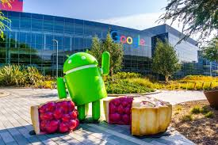
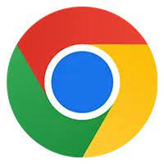
Google
july
2025
ALL YOU NEED TO KNOW!

Slide 2

Contents
00
01
02
03
Background
Industry
Economics
Fun Facts
Aumi Ichiki Personal Training 20XX

Slide 3
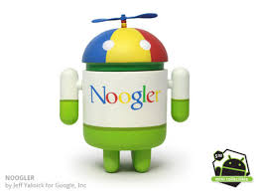
Background
Google was created by Larry Page and Sergey Brin in Sept 27, 1998. They created while working in their Stanford dorm room, making a search engine that used links to find things in the world wide web. It was originally named Backrub before changing the name to google. Many people got interested in Google and invested in it. Google was taking off.

Slide 4
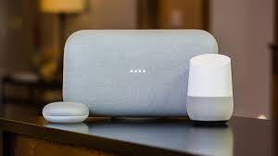
Google is mainly in the tech industry. This is what it is known for.
-Google Adds. Much of Google’s revenue comes from adds.
-Hardwear. Google has produced many phones, chromebooks and other tech devices.
-Artificial Intelligence. Google is deeply invested in AI, such as Google home and Gemini.
- Google search engine ofourse!

Slide 5
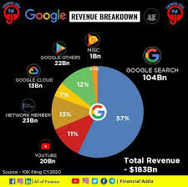
Google is publicly traded. Its current stock price is $197.90. Google has been producing revenue and its 2021 revenue was $257.637 billion. It was an increase of $41.15 from the last year 2020.

Slide 6


Fun Facts!
-Did you know that Google’s first office was a garage?
- Google has been fined multiple times.
- There are around 85 billion google searches per day.
- The original google hard drive was stored in a lego.
- Google is banned in Iran, North Korea, and China.
- In 2009 the california google uses goats to mow their lawn.

Slide 7
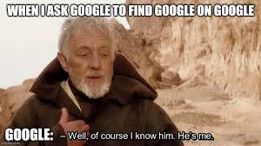
Bye!!

